Slide 1

Verifying Cyber-Physical Systems
Chapter 6 – Specifying Requirements
Abenezer Taye
Apr 19, 2022

Slide 2
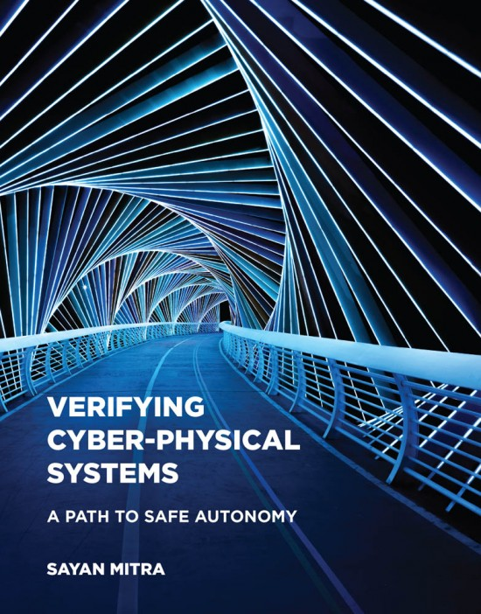
Chapter 6: Specifying Requirements

Slide 3
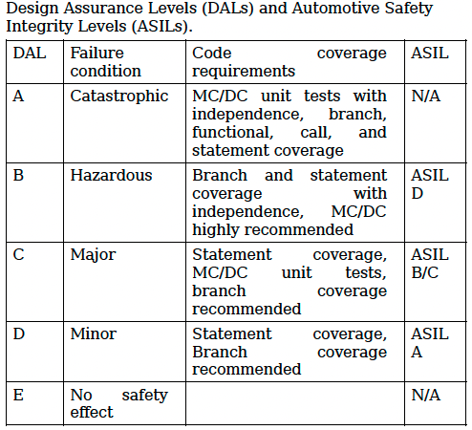
Safety Standards
Safety standards: provide guidelines and processes for developing safety-critical systems
DO-178C: a standard given by FAA for determining and certifying the airworthiness of aviation software
Has five assurance levels for software modules (aka Design Assurance Levels (DALs))
Modified Condition/Decision Coverage (MC/DC)
Is a test suite that requires
Each entry and exit point in the code be invoked
Each decision take every possible value
Each condition in a decision take every possible value

Slide 4
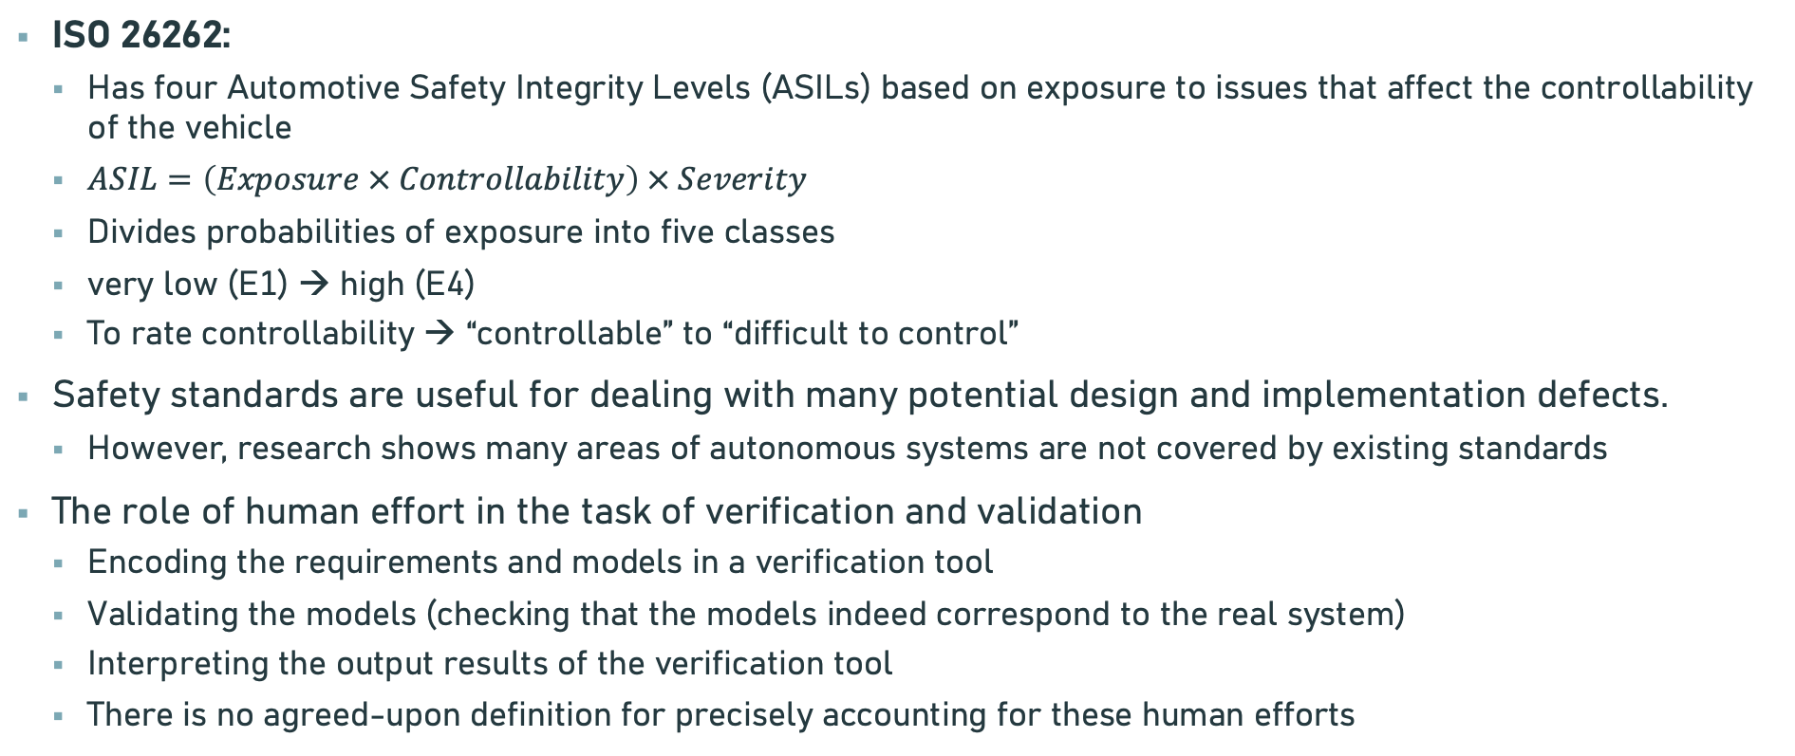
Safety Standards
ISO 26262:
Has four Automotive Safety Integrity Levels (ASILs) based on exposure to issues that affect the controllability of the vehicle
$ASIL=\left(Exposure × Controllability\right) × Severity$
Divides probabilities of exposure into five classes
very low (E1) → high (E4)
To rate controllability → “controllable” to “difficult to control”
Safety standards are useful for dealing with many potential design and implementation defects.
However, research shows many areas of autonomous systems are not covered by existing standards
The role of human effort in the task of verification and validation
Encoding the requirements and models in a verification tool
Validating the models (checking that the models indeed correspond to the real system)
Interpreting the output results of the verification tool
There is no agreed-upon definition for precisely accounting for these human efforts

Slide 5

Safety requirements
Invariant: capture the idea that “some things always hold” or equivalently, “bad things never happen”.
A candidate invariant I is an invariant if all states along all executions of A satisfy I

Slide 6

Introduction
Cyber Physical System (CPS): systems that are controlled by computer
Requirements for CPS: the desired or claimed behaviors of the system (aka specifications or properties)

Slide 7
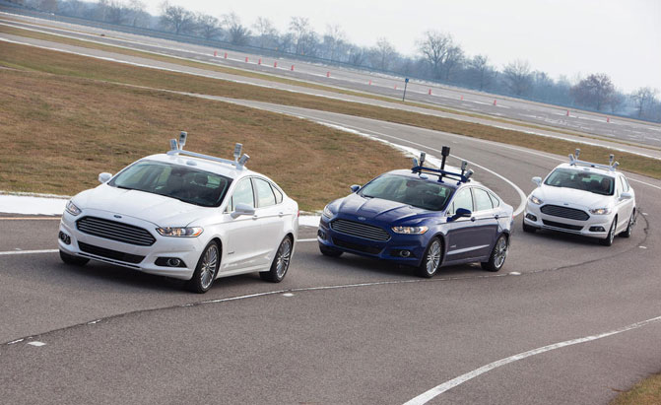
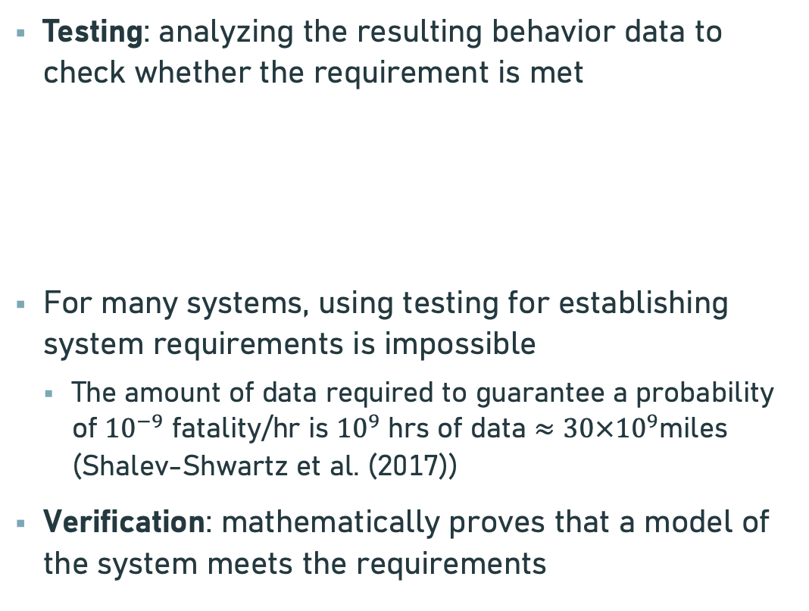
Testing Vs Verification
Testing: analyzing the resulting behavior data to check whether the requirement is met
For many systems, using testing for establishing system requirements is impossible
The amount of data required to guarantee a probability of ${10}^{−9}$ fatality/hr is ${10}^{9}$ hrs of data $≈30×{10}^{9}$miles (Shalev-Shwartz et al. (2017))
Verification: mathematically proves that a model of the system meets the requirements
Initial
condition
System
Output
Input

Slide 8
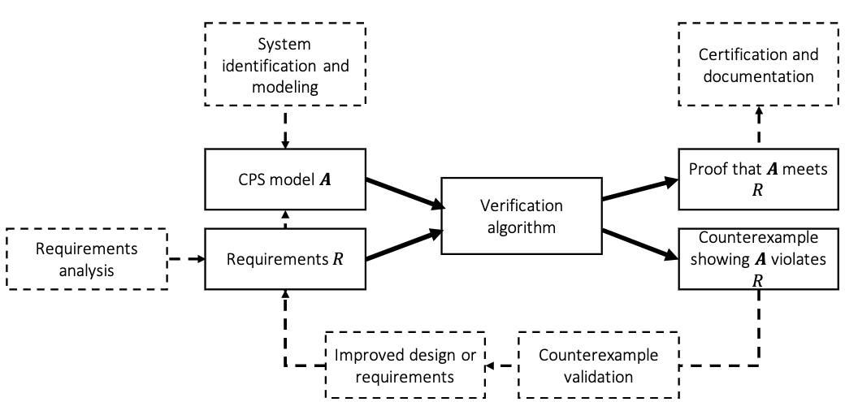
System Design Ecosystem

Slide 9
Challenges of Verification
Theoretical undecidability :
There is no algorithm that checks whether a model of CPS meets a requirement.
To address this → relaxing the verification question (e.g. bounded time horizon or tolerate some false positives)
Practical Scalability :
Lack of scalability is a huge challenge for the progress in verification
Missing Models :
Complete models of CPS systems are difficult to come by
Oftentimes models lack succinct descriptions, are distributed, and are protected intellectual property
Learning-enabled systems and missing requirements :
Recent CPS systems use DNN ➔ lack models and requirements

Slide 10
Chapter 2: MODELING COMPUTATION

Slide 11
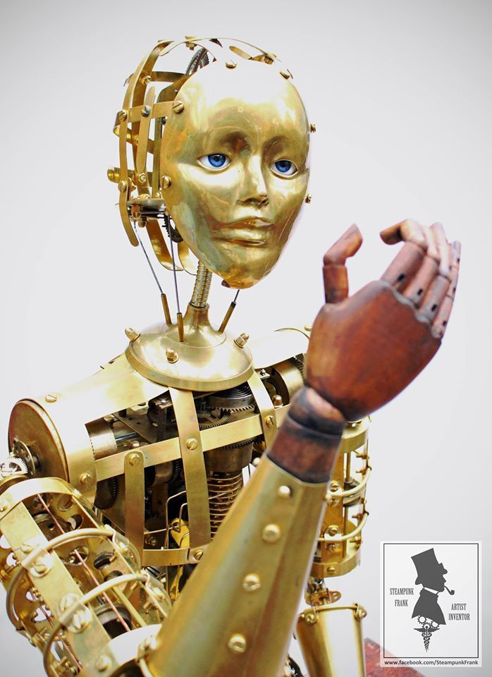
Introduction
Aim: how can we develop a mathematical model for computation
We use differential equations to model physical systems ➔ how about computation?
Automaton: 19th century word used to describe mechanical dolls
In mathematics, we use automaton to describe the rules of state change of any computational process
Aka, discrete-time transition system or a state machine

Slide 12
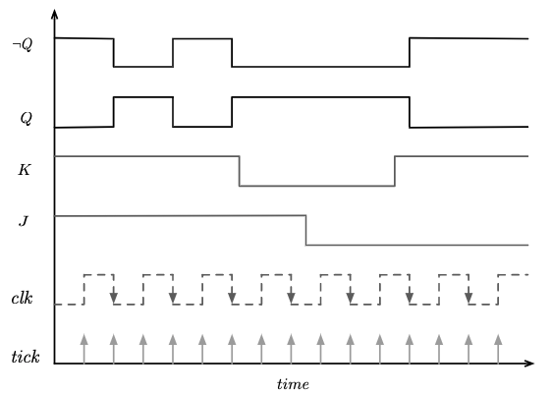
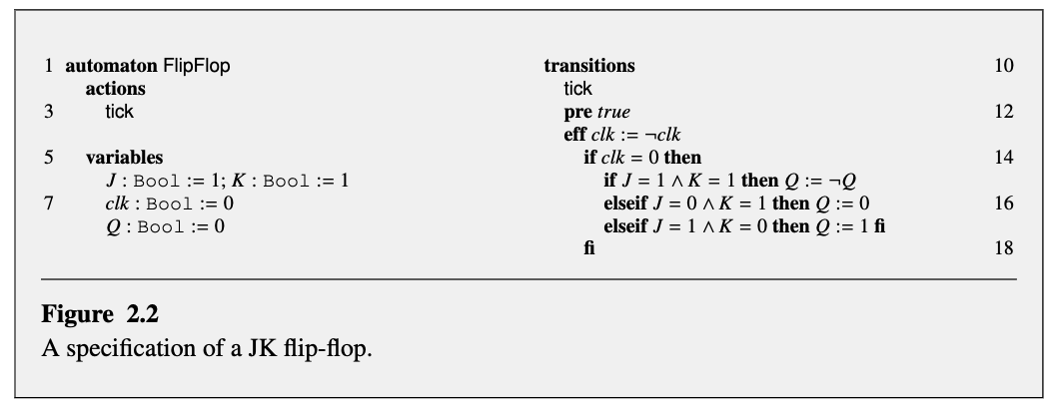
Example: JK Flip-Flop
clk | J | k | Q
0 | 0 | 0 | previous
0 | 0 | 1 | 0
0 | 1 | 0 | 1
0 | 1 | 1 | toggle
Parts of specification
Actions: lists various types of rules for state change
Variables: lists the state variables
Transitions: lists the state change rules for each of the actions

Slide 13


Specifying automata
State variables:
A state represents the information necessary for predicting the future of an automaton
Valuation:
Maps each state variable name to a value
Predicates:
A Boolean–valued formula involving the variables in V (we use it as a requirement)
For example: the state satisfies the formula
Because
Transitions:
Specify the rules for state change in a computation

Slide 14
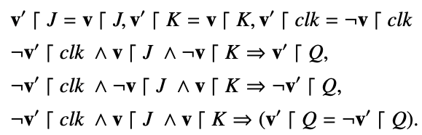

Automata
An automaton $𝓐$ is a tuple $\left(V,Θ,A,𝓓\right)$, where
V is a set of state variables and val(V) is valuations of V
$Θ⊆val(C)$ is a set of start states
A is a set of actions
$𝒟⊆val(V)×A×val(V)$ is called the set of transitions

Slide 15
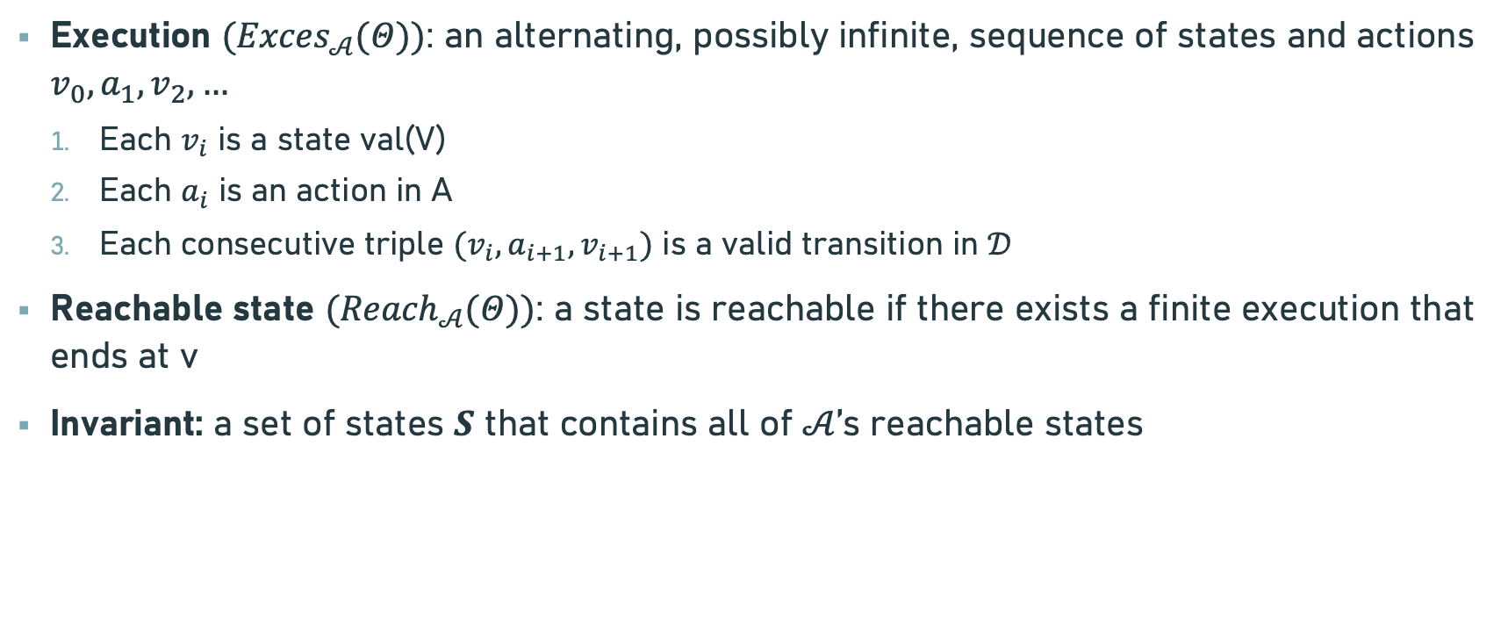
Semantics
Execution $({Exces}_{𝒜}(Θ))$: an alternating, possibly infinite, sequence of states and actions $v_{0}, a_{1}, v_{2},…$
Each $v_{i}$ is a state val(V)
Each $a_{i}$ is an action in A
Each consecutive triple $(v_{i}, a_{i+1}, v_{i+1})$ is a valid transition in $𝒟$
Reachable state $({Reach}_{𝒜}(Θ))$: a state is reachable if there exists a finite execution that ends at v
Invariant: a set of states $S$ that contains all of $𝒜$’s reachable states

Slide 16
Thank You!!!

